Slide 1
Detecting Exoplanets and recovering Parameters
What results could I arrive at over the last couple weeks?

Slide 2
Points of interest
Short Recap of the project
Ice Giant bugfixes
LISA improvements
Parameter space for verification binaries
LISA x IceGiant (x Taiji?)

Slide 3
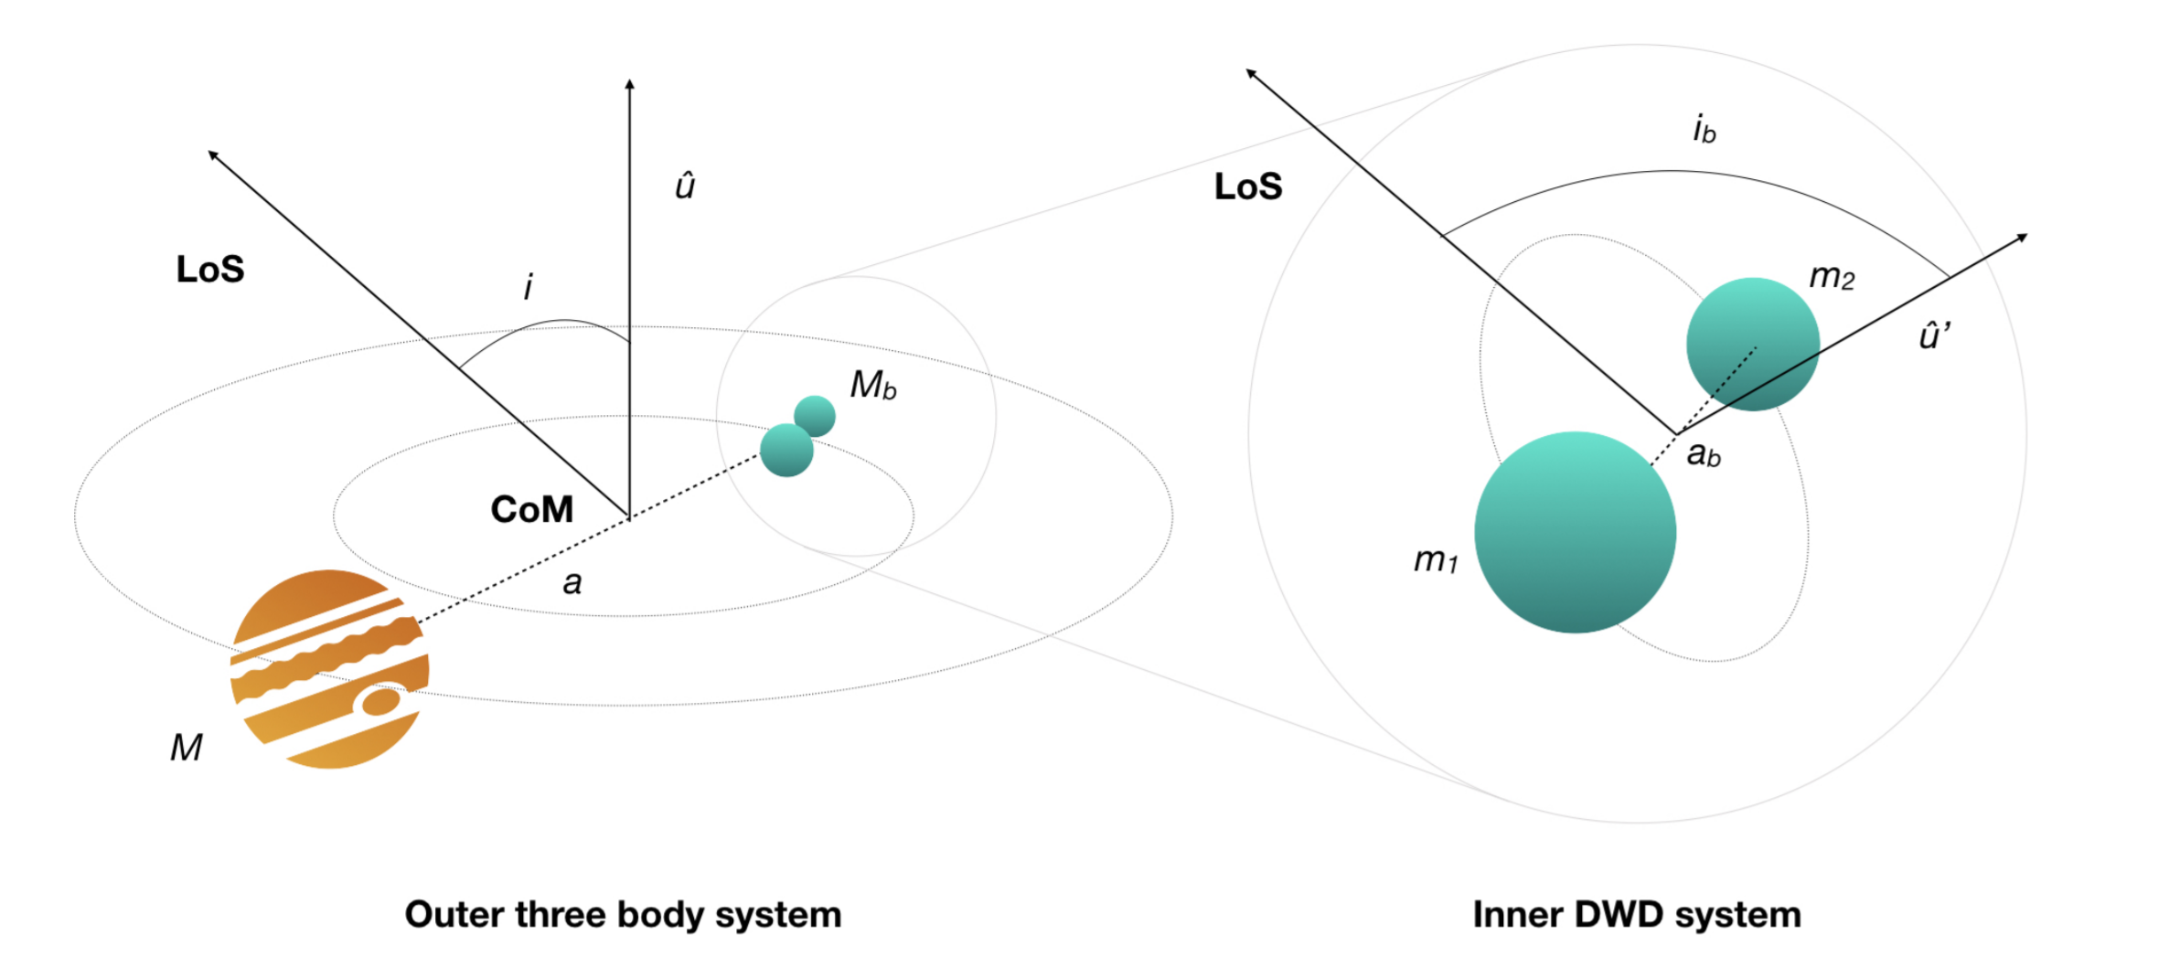
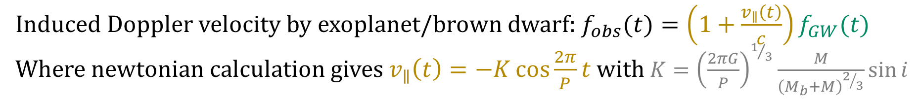
1. Short Recap: Exoplanets
Induced Doppler velocity by exoplanet/brown dwarf: $f_{obs}(t)=\left(1+\frac{v_{∥}\left(t\right)}{c}\right)f_{GW}(t)$
Where newtonian calculation gives $v_{∥}\left(t\right)=−K\cos{\frac{2π}{P}t}$ with $K={\left(\frac{2πG}{P}\right)}^{1/3}\frac{M}{{\left(M_{b}+M\right)}^{2/3}}\sin{i}$

Slide 4
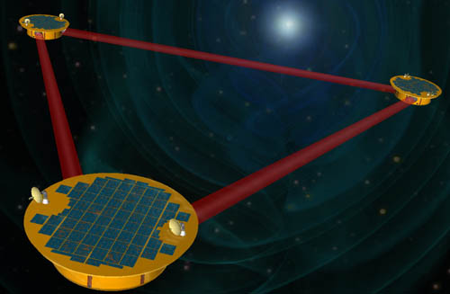
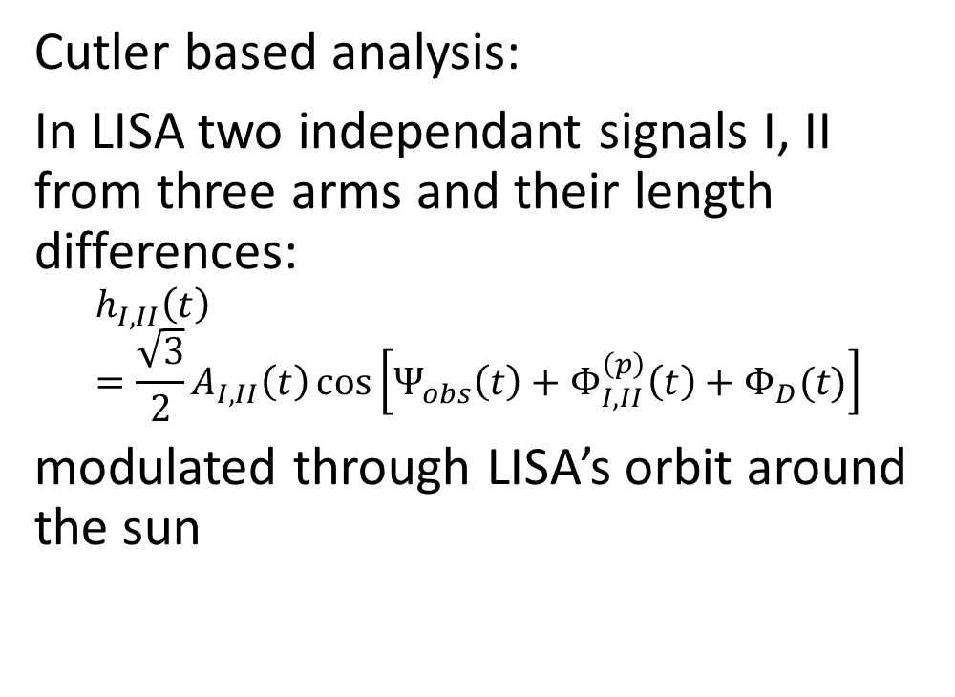
1. Short Recap: LISA
Cutler based analysis:
In LISA two independant signals I, II from three arms and their length differences:
$$h_{I,II}\left(t\right)=\frac{\sqrt{3}}{2}A_{I,II}\left(t\right)\cos\left[Ψ_{obs}\left(t\right)+Φ_{I,II}^{\left(p\right)}\left(t\right)+Φ_{D}(t)\right]$$
modulated through LISA’s orbit around the sun
$$h_{II}\left(t\right)$$
$$h_{I}\left(t\right)$$

Slide 5
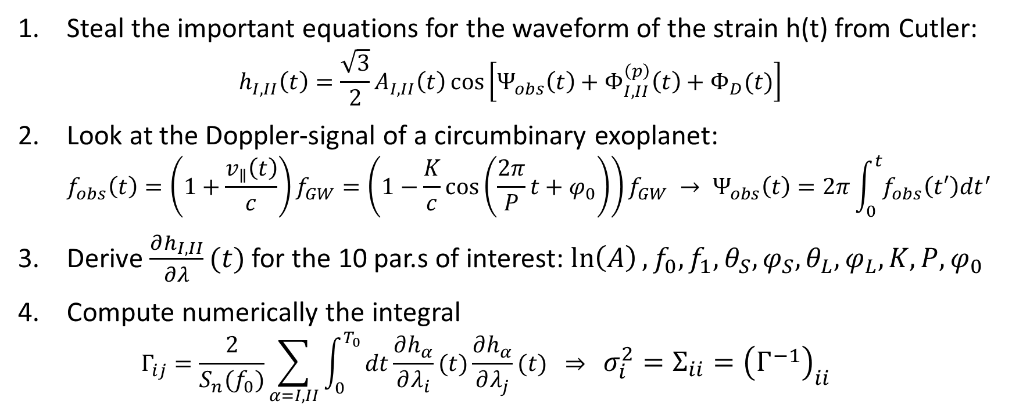
1. Short Recap: Fisher information approach
Steal the important equations for the waveform of the strain h(t) from Cutler: $h_{I,II}\left(t\right)=\frac{\sqrt{3}}{2}A_{I,II}\left(t\right)\cos\left[Ψ_{obs}\left(t\right)+Φ_{I,II}^{\left(p\right)}\left(t\right)+Φ_{D}(t)\right]$
Look at the Doppler-signal of a circumbinary exoplanet: $f_{obs}\left(t\right)=\left(1+\frac{v_{∥}\left(t\right)}{c}\right)f_{GW}=\left(1−\frac{K}{c}\cos\left(\frac{2π}{P}t+φ_{0}\right)\right)f_{GW} → Ψ_{obs}\left(t\right)=2π\int_{0}^{t}{f_{obs}\left(t′\right)dt^{′}}$
Derive $\frac{∂h_{I,II}}{∂λ}(t)$ for the 10 par.s of interest: $\ln\left(A\right), f_{0},f_{1},θ_{S},φ_{S},θ_{L},φ_{L},K,P,φ_{0}$
Compute numerically the integral $Γ_{ij}=\frac{2}{S_{n}(f_{0})}\sum_{α=I,II}{\int_{0}^{T_{0}}{dt\frac{∂h_{α}}{∂λ_{i}}(t)\frac{∂h_{α}}{∂λ_{j}}(t)} } ⇒ σ_{i}^{2}=Σ_{ii}={\left(Γ^{−1}\right)}_{ii}$

Slide 6
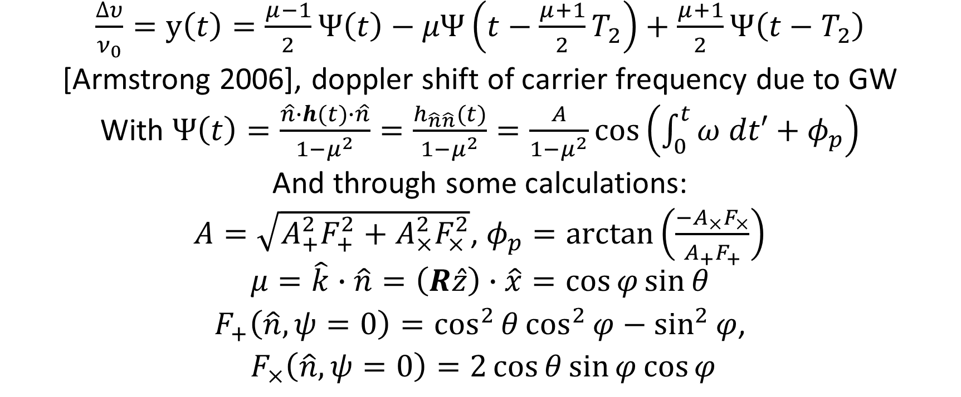
1. Short recap: IceGiant mission
$\frac{∆υ}{ν_{0}}=y\left(t\right)=\frac{μ−1}{2}Ψ\left(t\right)−μΨ\left(t−\frac{μ+1}{2}T_{2}\right)+\frac{μ+1}{2}Ψ\left(t−T_{2}\right)$
[Armstrong 2006], doppler shift of carrier frequency due to GW
With $Ψ\left(t\right)=\frac{\hat{n}∙h(t)∙\hat{n}}{1−μ^{2}}=\frac{h_{\hat{n}\hat{n}}(t)}{1−μ^{2}}=\frac{A}{1−μ^{2}}\cos\left(\int_{0}^{t}{ω dt′}+φ_{p}\right)$
And through some calculations:
$A=\sqrt{A_{+}^{2}F_{+}^{2}+A_{×}^{2}F_{×}^{2}}$, $φ_{p}=arctan\left(\frac{−A_{×}F_{×}}{A_{+}F_{+}}\right)$
$$μ=\hat{k}∙\hat{n}=\left(R\hat{z}\right)∙\hat{x}=\cos{φ}\sin{θ}$$
$F_{+}\left(\hat{n},ψ=0\right)=\cos^{2}{θ}\cos^{2}{φ}−\sin^{2}{φ}$,
$F_{×}\left(\hat{n},ψ=0\right)=2\cos{θ}\sin{φ}\cos{φ}$

Slide 7
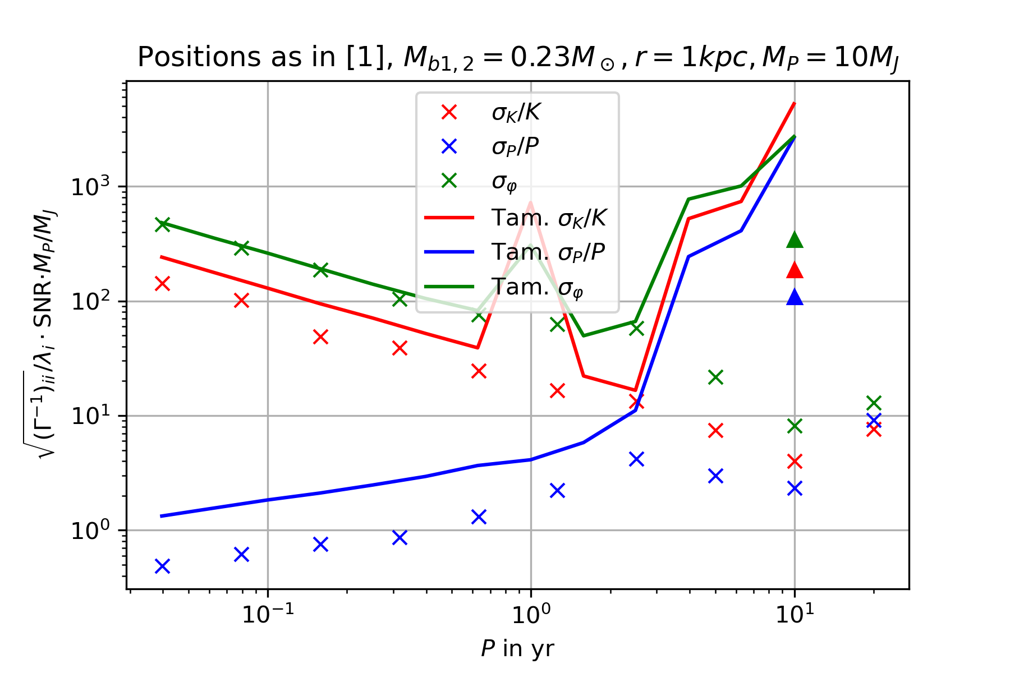
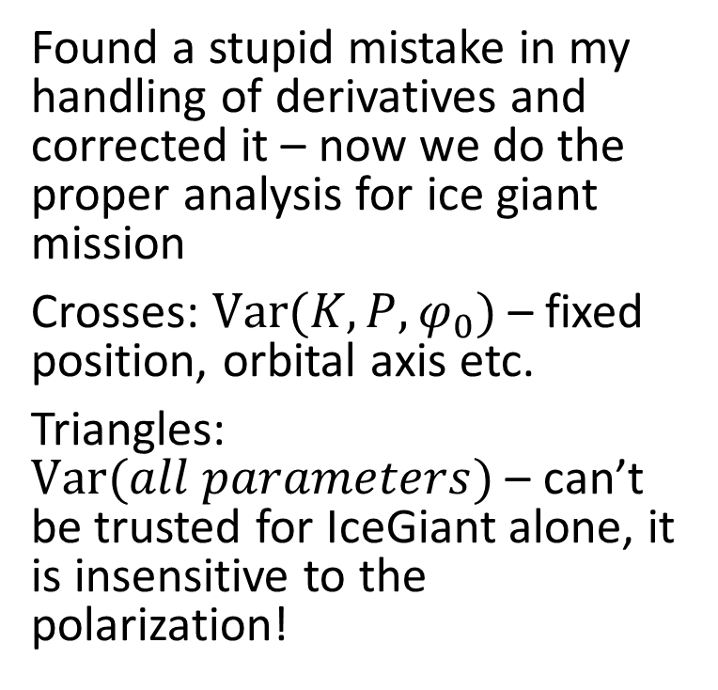
2. IceGiant bugfixes
Found a stupid mistake in my handling of derivatives and corrected it – now we do the proper analysis for ice giant mission
Crosses: $Var(K,P,φ_{0})$ – fixed position, orbital axis etc.
Triangles: $Var(all parameters)$ – can’t be trusted for IceGiant alone, it is insensitive to the polarization!

Slide 8
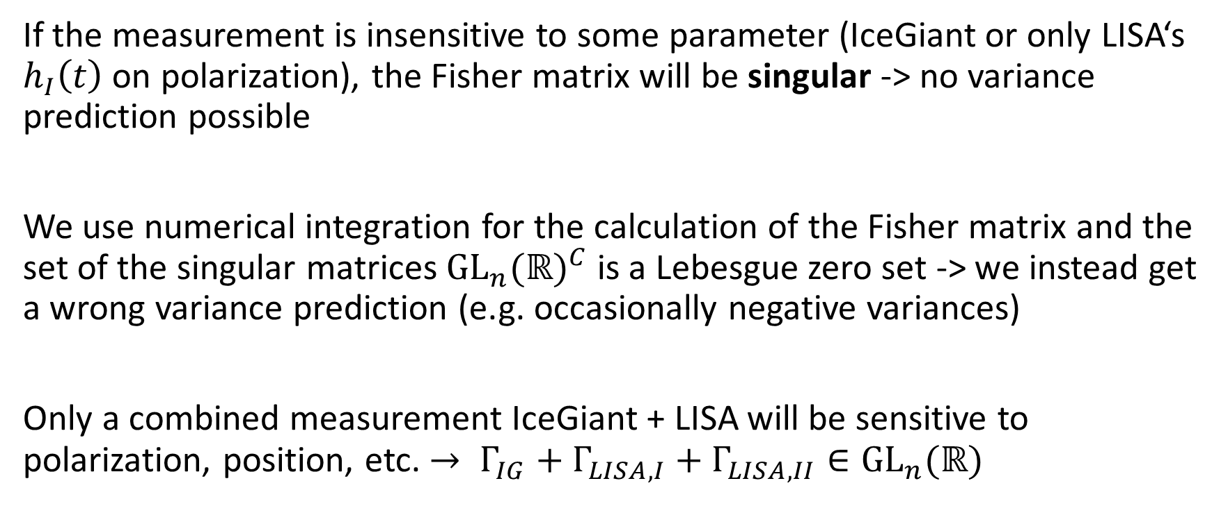
2. The big mistake
If the measurement is insensitive to some parameter (IceGiant or only LISA‘s $h_{I}\left(t\right)$ on polarization), the Fisher matrix will be singular -> no variance prediction possible
We use numerical integration for the calculation of the Fisher matrix and the set of the singular matrices ${{GL}_{n}(ℝ)}^{C}$ is a Lebesgue zero set -> we instead get a wrong variance prediction (e.g. occasionally negative variances)
Only a combined measurement IceGiant + LISA will be sensitive to polarization, position, etc. $→ Γ_{IG}+Γ_{LISA, I}+Γ_{LISA, II}∈{GL}_{n}(ℝ)$

Slide 9
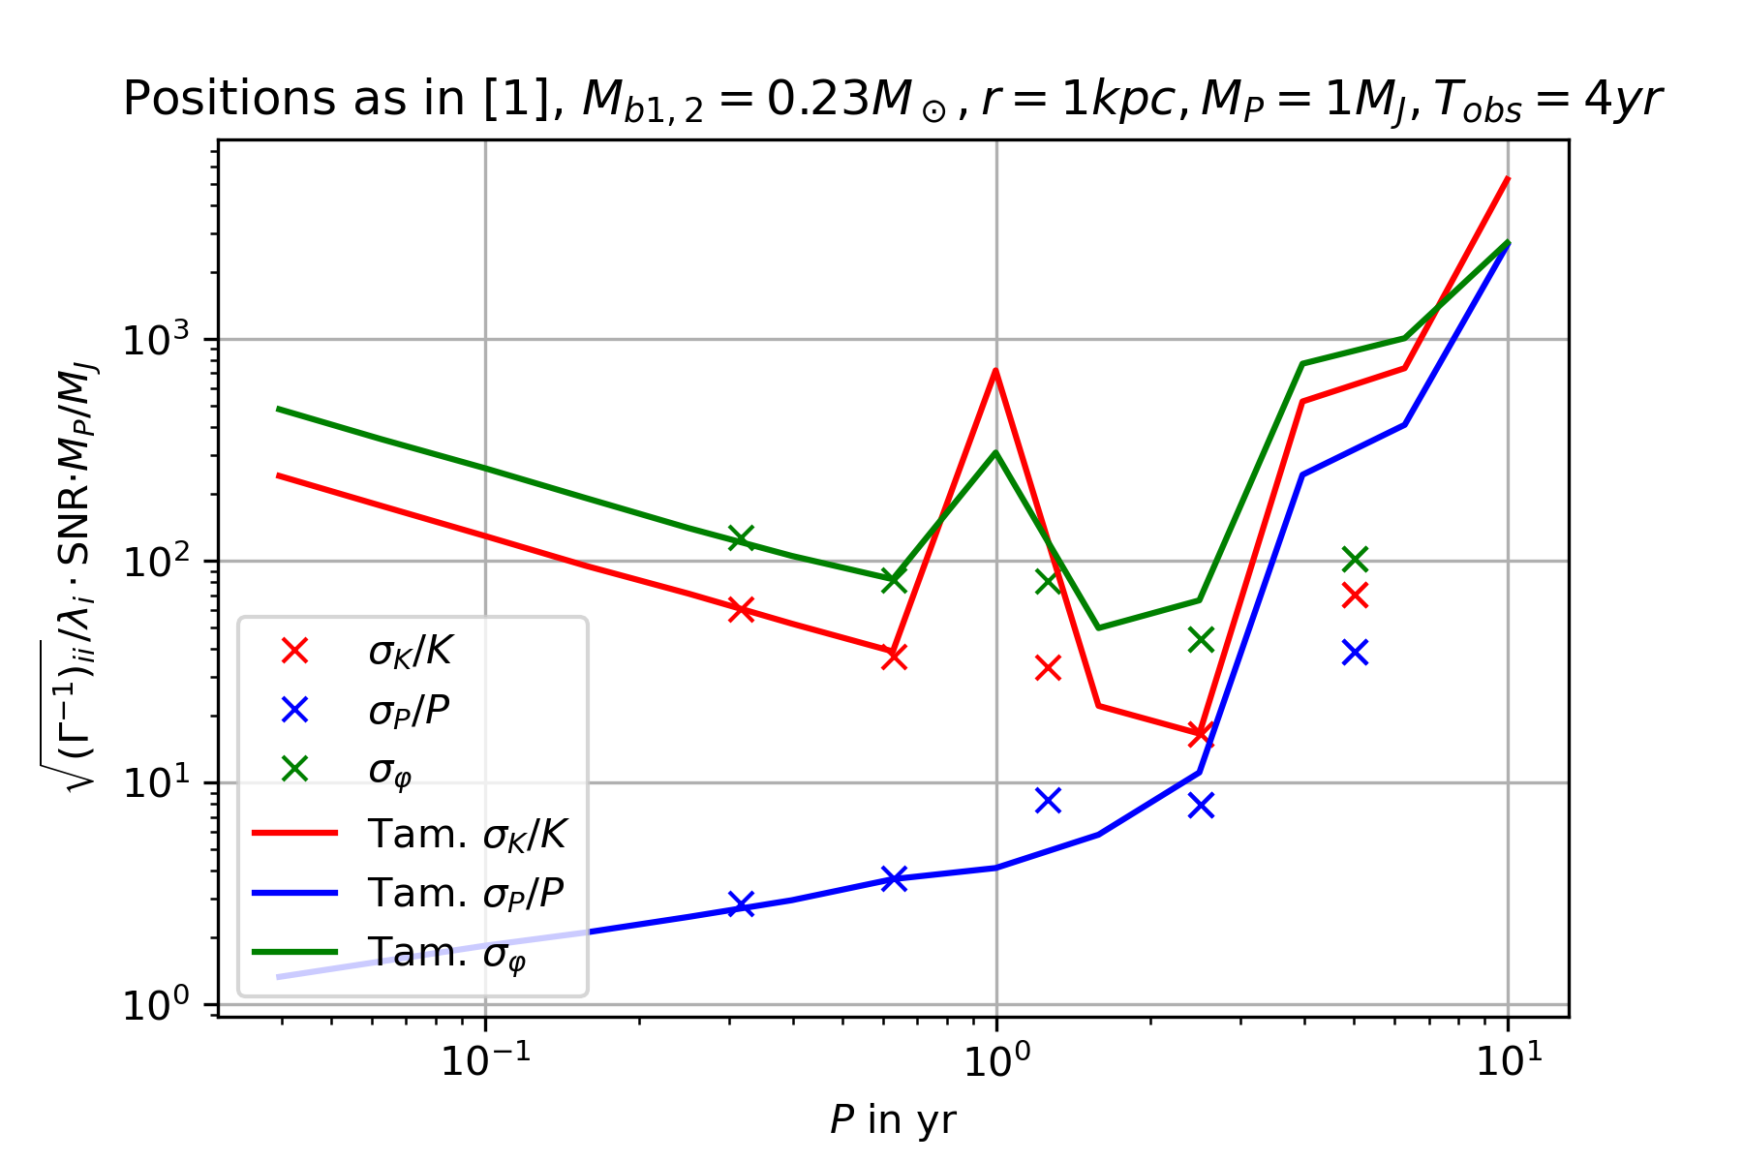
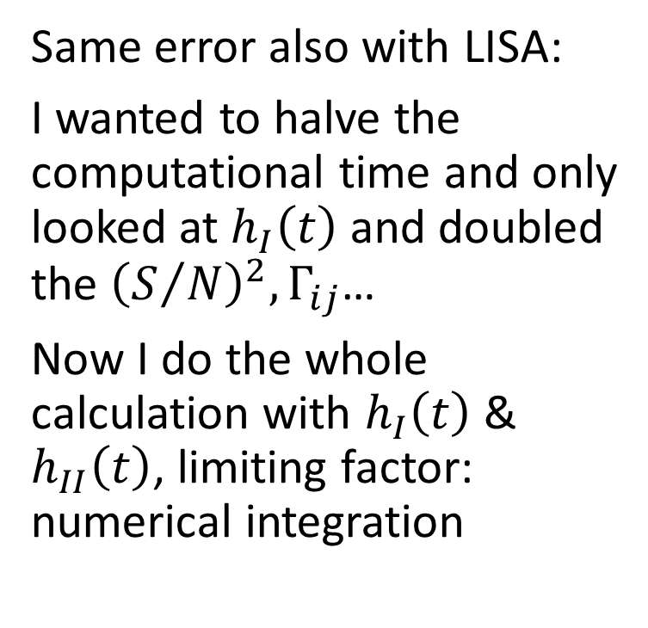
3. LISA improvements
Same error also with LISA:
I wanted to halve the computational time and only looked at $h_{I}\left(t\right)$ and doubled the ${\left(S/N\right)}^{2}, Γ_{ij}$…
Now I do the whole calculation with $h_{I}\left(t\right)$ & $h_{II}\left(t\right)$, limiting factor: numerical integration

Slide 10
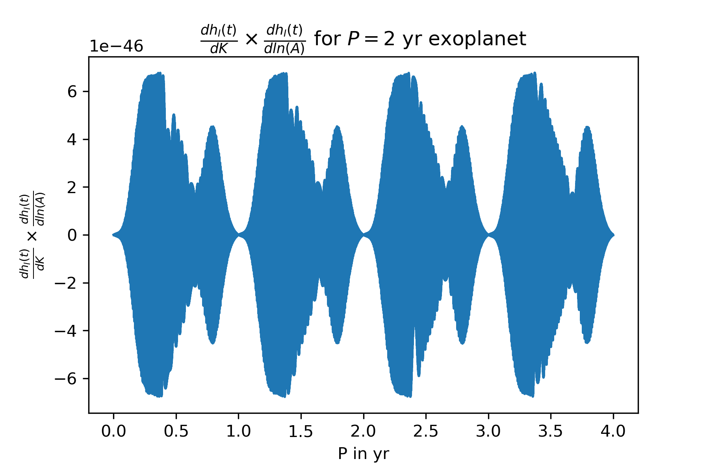
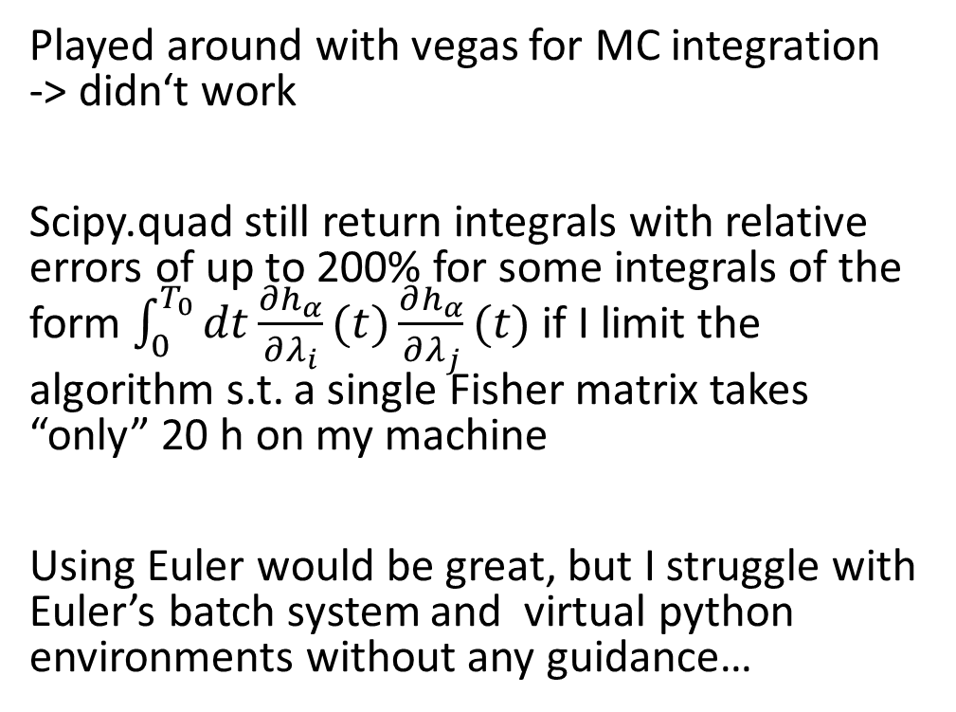
3. LISA improvements: Integration
Played around with vegas for MC integration -> didn‘t work
Scipy.quad still return integrals with relative errors of up to 200% for some integrals of the form $\int_{0}^{T_{0}}{dt\frac{∂h_{α}}{∂λ_{i}}(t)\frac{∂h_{α}}{∂λ_{j}}(t)}$ if I limit the algorithm s.t. a single Fisher matrix takes “only” 20 h on my machine
Using Euler would be great, but I struggle with Euler’s batch system and virtual python environments without any guidance…

Slide 11
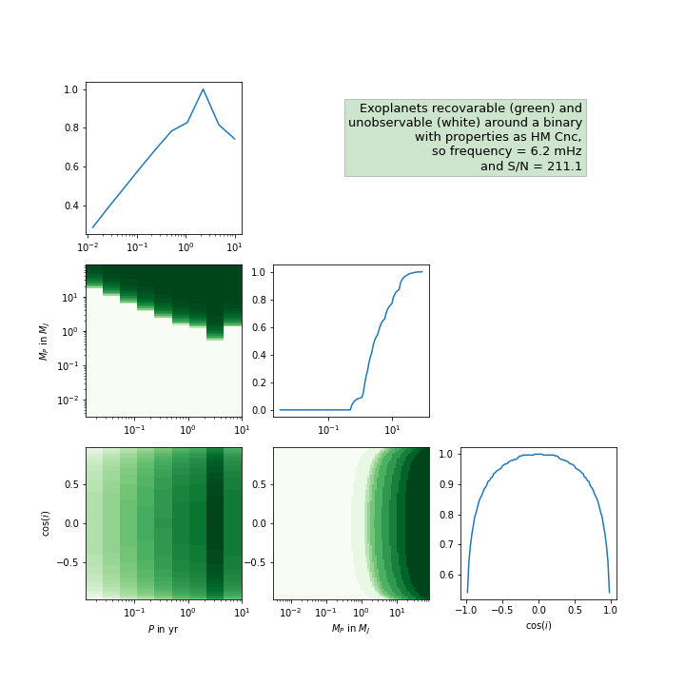

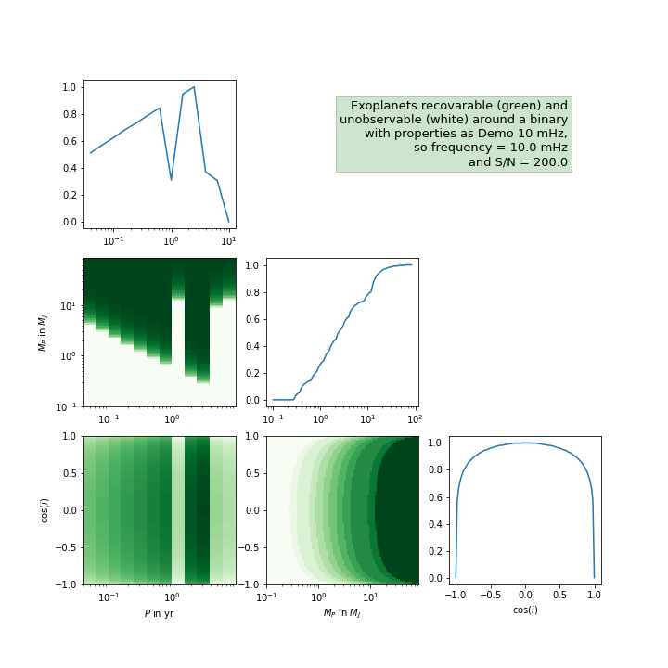
4. Parameter space exoplanets
With Lorenz and Deniz: For which exoplanet parameters are we able to observe them? -> Impossible to answer without priors on parameter space

Slide 12
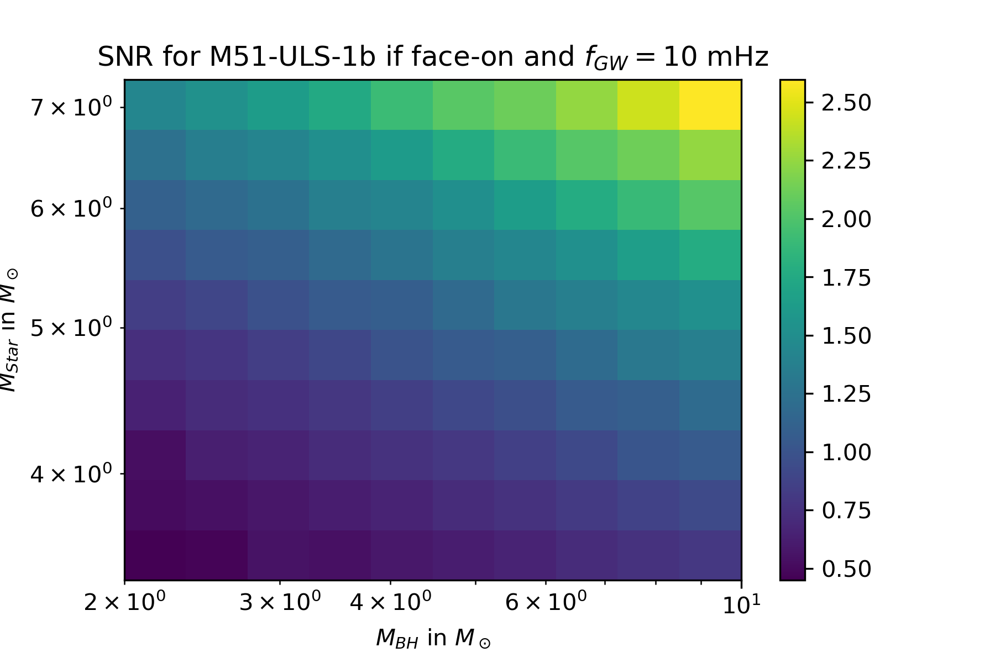
4. X-Ray binaries
We also took a small look at exoplanets around X-Ray binaries, but don‘t know how to constrain the orbital frequencies of such systems
Idea: Minimal orbit around BH s.t. the Roche lobe isn‘t traversed by the star, i.e. the star isn‘t tidally disrupted

Slide 13
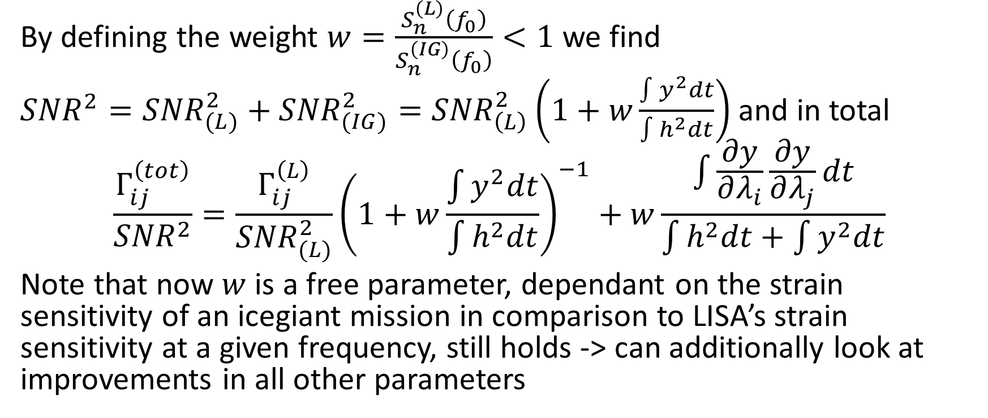
5. Combining measurements
By defining the weight $w=\frac{S_{n}^{\left(L\right)}\left(f_{0}\right)}{S_{n}^{\left(IG\right)}\left(f_{0}\right)}<1$ we find
${SNR}^{2}={SNR}_{(L)}^{2}+{SNR}_{(IG)}^{2}={SNR}_{\left(L\right)}^{2}\left(1+w\frac{\int{y^{2}dt}}{\int{h^{2}dt}}\right)$ and in total
$$\frac{Γ_{ij}^{\left(tot\right)}}{{SNR}^{2}}=\frac{Γ_{ij}^{\left(L\right)}}{{SNR}_{(L)}^{2}}{\left(1+w\frac{\int{y^{2}dt}}{\int{h^{2}dt}}\right)}^{−1}+w\frac{\int{\frac{∂y}{∂λ_{i}}\frac{∂y}{∂λ_{j}}}dt}{\int{h^{2}dt}+\int{y^{2}dt}}$$
Note that now $w$ is a free parameter, dependant on the strain sensitivity of an icegiant mission in comparison to LISA’s strain sensitivity at a given frequency, still holds -> can additionally look at improvements in all other parameters

Slide 14
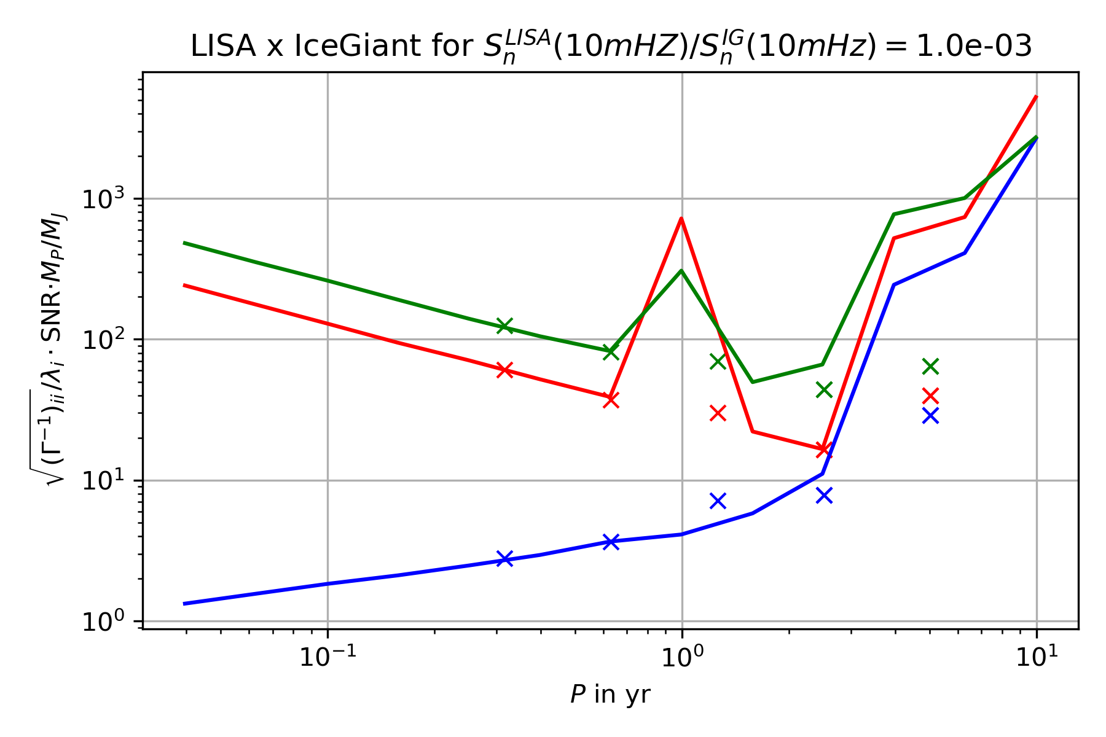
5. Combining measurements
Very slight decrease in uncertainties -> waiting for higher accuracy integration
+ Ice Giant mission

Slide 15
References
[1] Tamanini, N., Danielski, C. (2019). The gravitational-wave detection of exoplanets orbiting white dwarf binaries using LISA. Nat Astron 3, 858–866. https://doi.org/10.1038/s41550-019-0807-y
[2] Danielski, C., Korol, V., Tamanini, N., & Rossi, E.M. (2019). Circumbinary exoplanets and brown dwarfs with the Laser Interferometer Space Antenna. Astronomy and Astrophysics, 632.
[3] Cutler, C. (1998). Angular resolution of the LISA gravitational wave detector. Physical Review D, 57, 7089-7102.
[4] Soyuer, D., Zwick, L., D’Orazio, D., Saha, P. (2021). Searching for gravitational waves via Doppler tracking by future missions to Uranus and Neptune. MNRAS: Letters, 503, 1, L73-79. https://doi.org/10.1093/mnrasl/slab025
[5] Maggiore, M. (2008). Gravitational Waves Volume 1: Theory and Experiments. Oxford University Press
…

